Slide 1
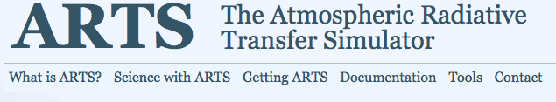
Introduction
Advanced Radiation and Remote Sensing
Winter Term 2016
Stefan Bühler
Meteorologisches Institut
Universität Hamburg

Slide 2
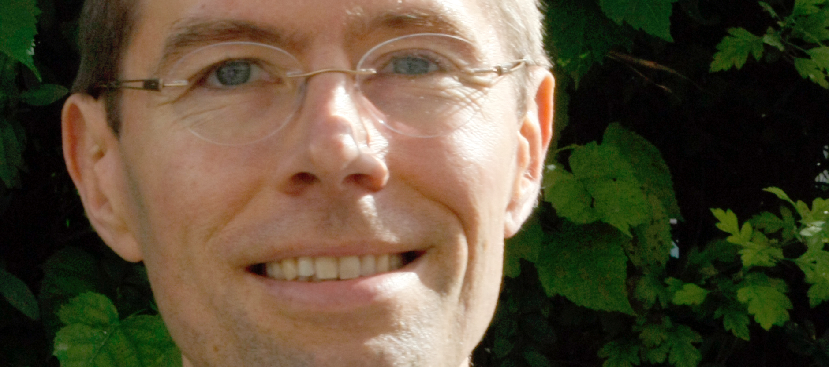
Contact
Stefan Bühler
Raum 1534 (Geomatikum)
Tel. +49 40 42838 8124
Email: stefan.buehler(at)uni-hamburg.de
Notes:
Seit 1 Monat in Hamburg.
Möchte gerne Bilder, um Namen lernen zu können

Slide 3
Modus operandi
Mixture of short lecture and a lot of practical exercises, all in the same place and time slot.
Examination: Short project towards the end of the course.
This course is experimental and meant to be rugged. Don’t expect any polish. Don’t even expect everything to work properly.

Slide 4
Main tool
Most (all?) exercises will somehow involve our own radiative transfer model: ARTS
After the course, you should be able to use ARTS and the tools around it for your own projects!

Slide 5
Roadmap
Spectroscopy
Rotational spectra
Vibrational spectra
Line shape
Radiative transfer
Brightness temperature and radiative transfer
Jacobians and the opacity rule
Thermal radiation transports energy
Outgoing longwave radiation
Heating rates
Radiation field inside a cloud
Diverse datasets and meteorological sensors
Solar shortwave fluxes and heating rates
Increasingly uncertain

